Slide 1
Angle Modulation
Maj Chanaka Ranasinghe

Slide 2
Angle Modulation is the process in which the frequency or the phase of the carrier signal varies according to the message signal.
The standard equation of the angle modulated wave is
Where,
Ac is the amplitude of the modulated wave, which is the same as the amplitude of the carrier signal
θi(t) is the angle of the modulated wave

Slide 3
Why Angle Modulation??
It provides better noise discrimination against noise and interference than Amplitude Modulation.
Provides us with a practical means of exchanging channel bandwidth for improved noise performances which is not possible in Amplitude modulation.
Note:
Improvement in noise performance in angle modulation is achieved at the cost of increased system complexity in both the transmitter and the receiver.

Slide 4
Angle modulation is further divided into frequency modulation and phase modulation.
Frequency Modulation is the process of varying the frequency of the carrier signal linearly with the message signal.
Phase Modulation is the process of varying the phase of the carrier signal linearly with the message signal.

Slide 5
Frequency Modulation
In amplitude modulation, the amplitude of the carrier signal varies.
Whereas, in Frequency Modulation (FM), the frequency of the carrier signal varies in accordance with the instantaneous amplitude of the modulating signal.

Slide 6
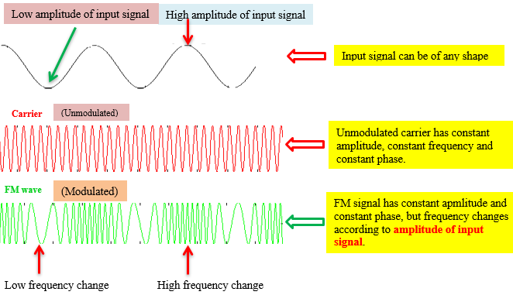
The frequency of the modulated wave increases, when the amplitude of the modulating or message signal increases. Similarly, the frequency of the modulated wave decreases, when the amplitude of the modulating signal decreases.
The frequency of the modulated wave remains constant and it is equal to the frequency of the carrier signal, when the amplitude of the modulating signal is zero.

Slide 7
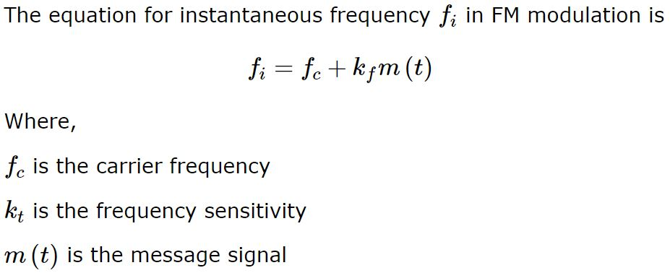
Mathematical Representation
- Measured in Hertz per Volt

Slide 8
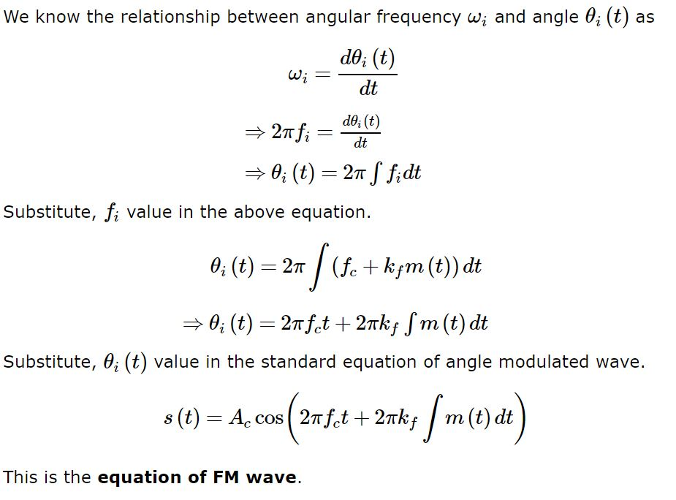
t
0
t
0
t
0
t
0

Slide 9
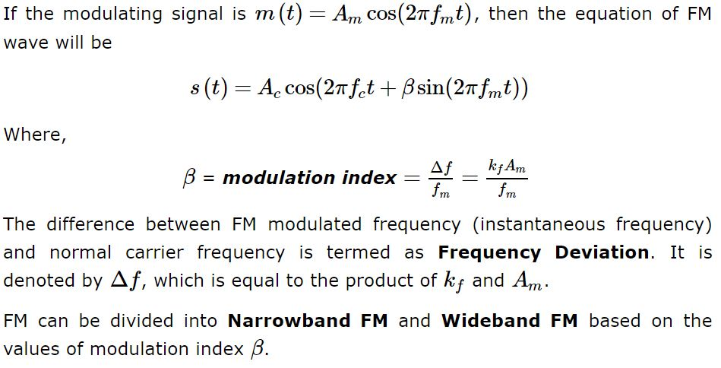
Narrow band FM β is very small compared to one radian.
Wide band FM β is large compared to one radian

Slide 10
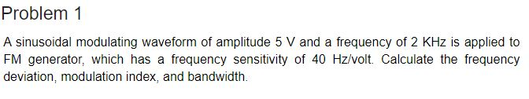
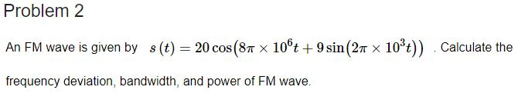

Slide 11



Properties of Angle Modulated Signal
1. Constancy of transmitted power:
Let us the Angle modulated wave equations as:
FM wave :
PM Wave :
You can see that the Amplitude of the FM and PM is maintained at a constant value equals to the carrier Amplitude Ac at all time t, irrespectively the sensitivity factors Kf and Kp. Therefore, regardless of the message Signal - m(t),
Average transmitted power is given :
t
0
Assume that Load resistance (RL) is 1 Ohms.

Slide 12


2. Non-linearity of the modulation process
Both PM and FM waves are violating the principle of superposition.
.
Assume message signal m3(t) is made up of two different components m1(t) and m2(t) as :
m3(t)=m1(t)+m2(t)
Let: S3(t), S1(t) and S2(t) denotes the PM waves produced by the m3(t), m1(t) and m2(t)
Same can be applied to FM also. Therefore, angle modulation is non-linear.

Slide 13
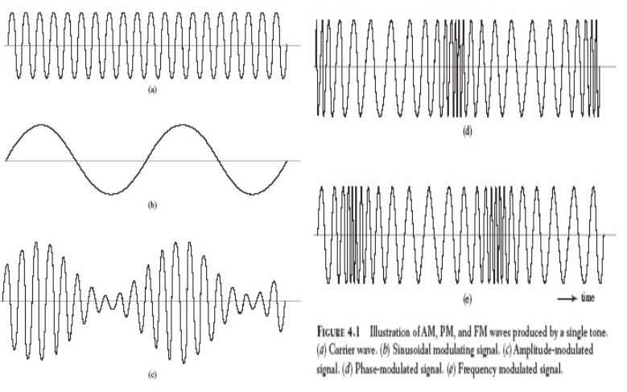
Irregularity of zero Crossing
Zero crossing is defined as instants of time, at which waveform changes amplitude from positive to negative or vice versa.
The irregularity of zero-crossings in angle-modulation wave is attributed to the nonlinear character of the modulation process
As shown on the graph there is no perfect regularity of modulated wave (right side graph)

Slide 14
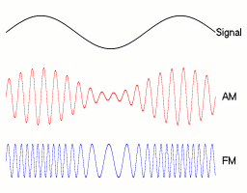
Visualization difficulty of message waveform
The difficulty in visualizing the message waveform in angle-modulated waves is also attributed to the nonlinear character of angle-modulated waves
Where in case of Amplitude Modulation, we can see the shape of the message wave form at the envelop of the modulated signal.

Slide 15
NARROWBAND FM
Following are the features of Narrowband FM.
This frequency modulation has a small bandwidth when compared to wideband FM.
The modulation index β is small, i.e., less than 1.
Its spectrum consists of the carrier, the upper sideband and the lower sideband.
This is used in mobile communications such as police wireless, ambulances, taxicabs, etc.

Slide 16
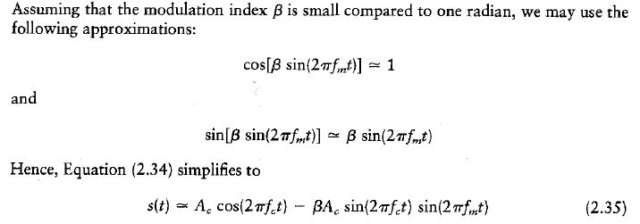
Consider the standard FM equation;
Expanding this equation using trigonometric identity we get:

Slide 17
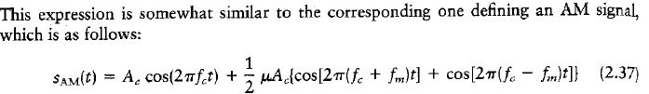
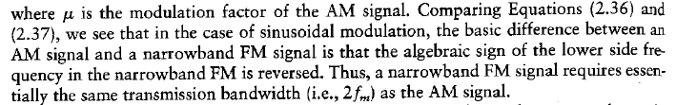
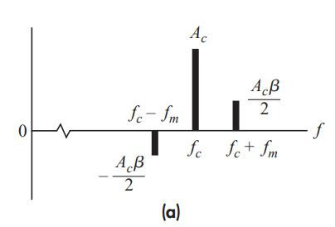
We can expand this equation again as:

Slide 18
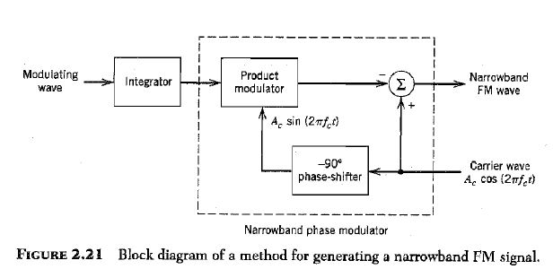
Generation of NBFM
m(t)
V0(t)
V1(t)
S(t)
Here, the integrator is used to integrate the modulating signal m(t) and the carrier wave is spitted to two parts by a phase shifter.

Slide 19
Let the modulating signal be, m(t)=Amcos(2πfmt)
carrier signal be, c(t)=Accos(2πfct)
Then we get V0(t) = βSin(2πfmt)
The Output of Product Modulator is V1(t)
V1(t) = V0(t).AcSin(2πfct)
    = βSin(2πfmt) AcSin(2πfct)
    = β AcSin(2πfmt) Sin(2πfct)
    As the output of the summer block we get
    S(t) = C(t) – V1(t)
    = Accos(2πfct) - β AcSin(2πfct) Sin(2πfmt)
    This is the equation which is received for the NBFM wave.

Slide 20
WIDEBAND FM
Following are the features of Wideband FM.
This frequency modulation has infinite bandwidth.
The modulation index β is large, i.e., higher than 1.
Its spectrum consists of a carrier and infinite number of sidebands, which are located around it.
This is used in entertainment, broadcasting applications such as FM radio, TV, etc

Slide 21

wide-band FM wave – WBFM
Modulating index – β >>1
The standard equation of the FM wave is;
This FM wave is produced by a sinusoidal modulating wave m(t), that is a periodic function of time t, only when fc = n.fm ( integral multiple of modulating frequency)
Note that, here fc is large enough to compared to BW of FM Wave.

Slide 22

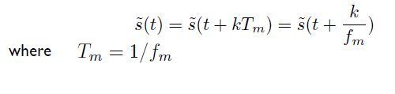
the FM modulated wave is calculated in complex mode:
It can be written as: (Real part of the complex quantity)
Where is called complex envelop .
Note that the complex envelope is a periodic function of time with a fundamental frequency equals to the fm, which means

Slide 23
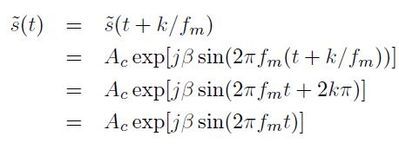

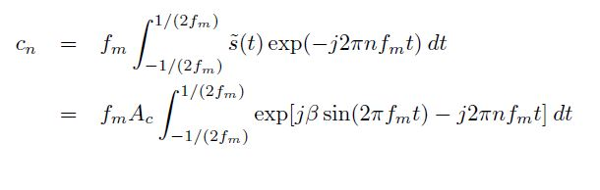
Then we can rewrite
We can Expand above equation as per the complex Fourier series form:
Where the complex Fourier Coefficient Cn is defined as:

Slide 24
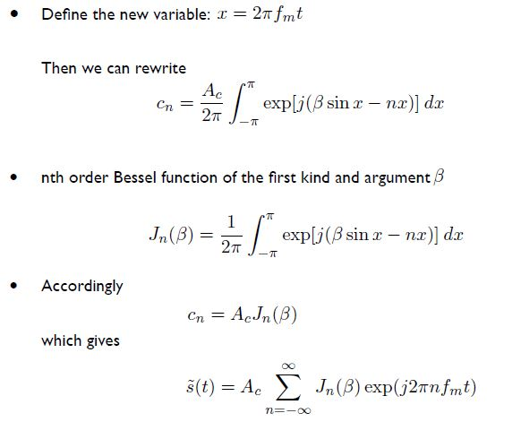
; Complex notation of the Bessel function

Slide 25
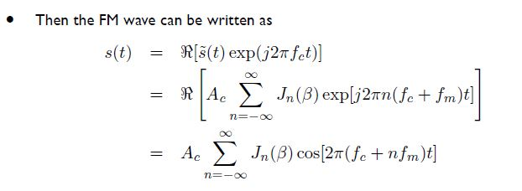

n
This is the desired form of the furrier series representation of the Single Tone FM Signal
For an arbitrary value of modulation index
Discrete Spectrum of FM is obtained by taking Furrier Transformation of both sides:

Slide 26
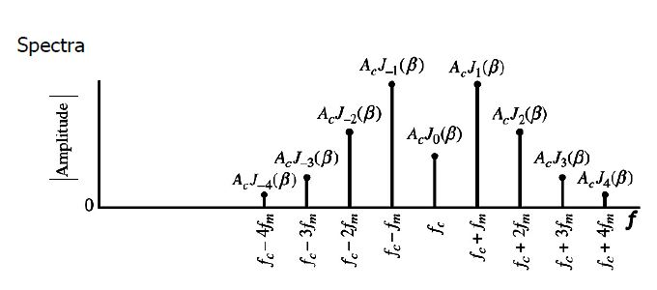
Above equation shows an infinite number of delta functions
spaced at fc +- nfm
For n= +- 0, +-1, +-2,…
Note: FM is composed of a carrier with a set of side band frequencies spaced symmetrically, on either side of the carrier at a frequency separation of fm, 2fm, 3fm, 4fm,…

Slide 27
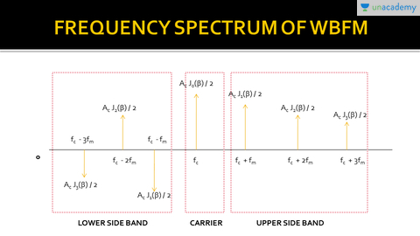

Slide 28
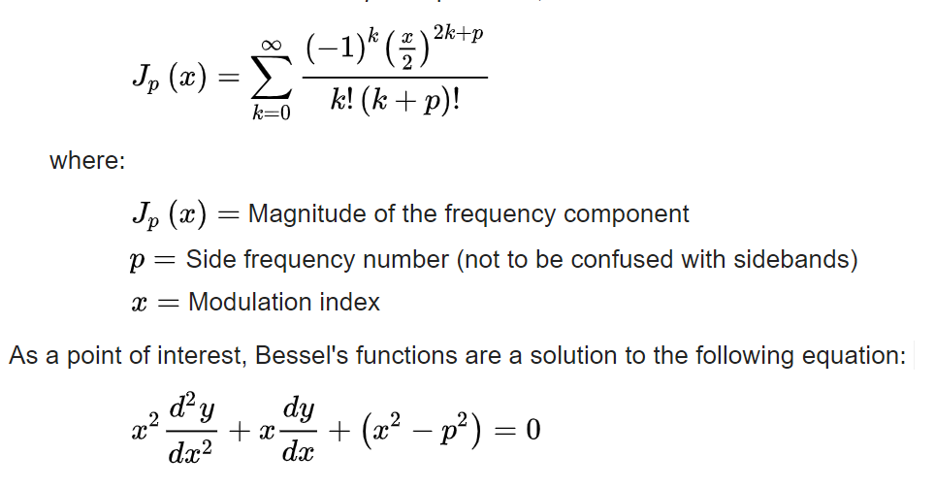
The variation of Bessel function determines the Amplitude of the varies sideband components of the WBFM.
BESSEL FUNCTION

Slide 29
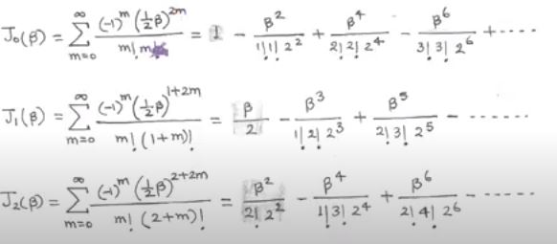
Special Points:
For small values of the β
  J0(β ) = 1
  J1(β ) = β/2
  Jn(β ) = 0 :for n>1

Slide 30
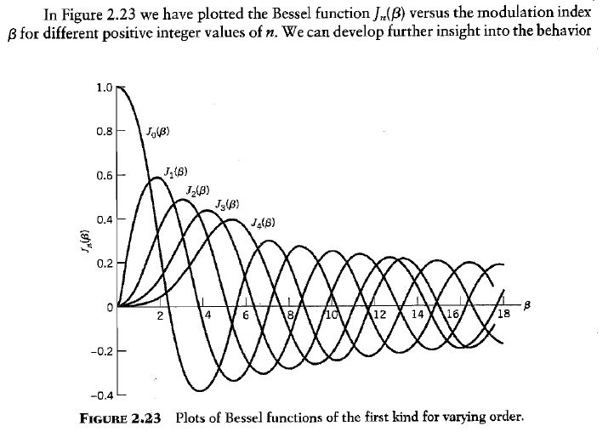

Slide 31
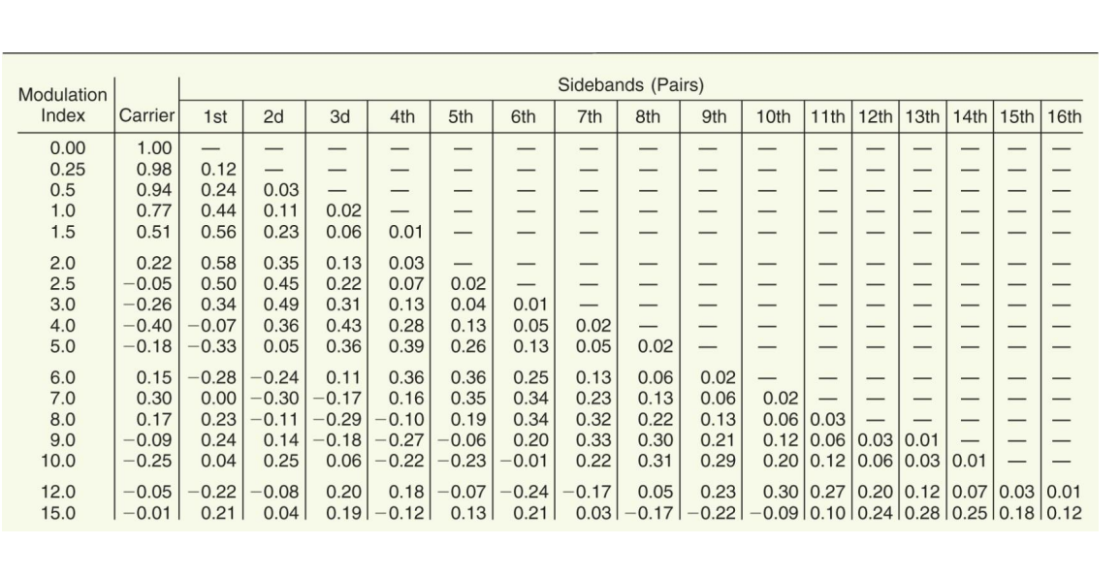
Bessel Table

Slide 32
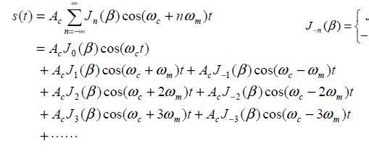

Slide 33
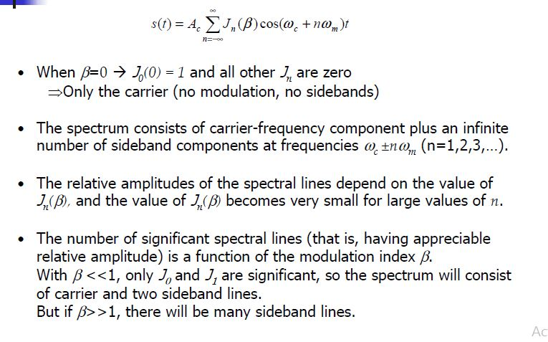

Slide 34
Transmission BW of WBFM Waves
In theory WBFM contains infinite number of side frequencies
Then the BW required to transmit WBFM wave is going to infinite.
But in practice, WBFM wave is effectively limited to finite number of significant side frequencies with significant amount of distortion.

Slide 35
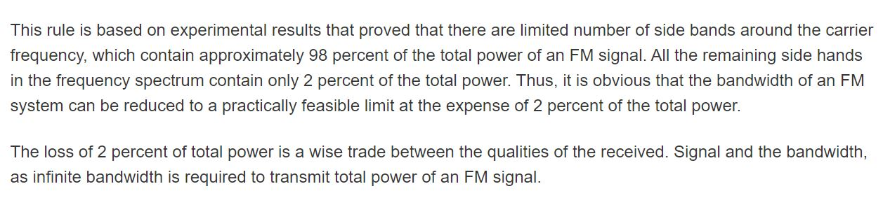

Transmission BW of WBFM Waves
Carson’s rule
The following formula, known as Carson’s rule is often used as an estimate of the WBFM signal bandwidth:
Carson’s rule : Bandwidth of an WBFM signal is given by:
Note: When β =0 or very less, it gives the BW of NBFM Waves as

Slide 36
Generation of WBFM
The following two methods generate WBFM wave.
Direct method
Indirect method

Slide 37
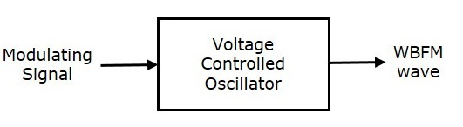
Direct Method
This method is called as the Direct Method because we are generating a wide band FM wave directly.
In this method, Voltage Controlled Oscillator (VCO) is used to generate WBFM.
A voltage-controlled oscillator (VCO) is an electronic oscillator whose oscillation frequency is controlled by a voltage input. The applied input voltage determines the instantaneous oscillation frequency.
VCO produces an output signal, whose frequency is proportional to the input signal voltage and this is similar to the definition of FM wave.
The block diagram of the generation of WBFM wave is shown in the following figure

Slide 38
Here, the modulating signal m(t) is applied as an input of Voltage Controlled Oscillator (VCO). VCO produces an output, which is nothing but the WBFM.
Because the Frequency is proportional to the input Voltage,
we can get : Fi α m(t)
⇒fi = fc + kfm(t)
Where, fi - instantaneous frequency of WBFM wave.
    fc – Un modulated carrier frequency

Slide 39
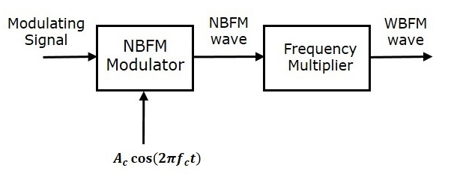
INDIRECT METHOD
This method is called as Indirect Method because we are generating a wide band FM wave indirectly.
This means, first we will generate NBFM wave and then with the help of frequency multipliers we will get WBFM wave
The block diagram of generation of WBFM wave is shown in the following figure.
This block diagram contains mainly two stages. In the first stage, the NBFM wave will be generated using NBFM modulator. We have seen the block diagram of NBFM modulator at the beginning of this chapter. We know that the modulation index of NBFM wave is less than one. Hence, in order to get the required modulation index (greater than one) of FM wave, choose the frequency multiplier value properly.

Slide 40
Here Frequency multiplier is a non-linear device, which produces an output signal whose frequency is ‘n’ times the input signal frequency. Where, ‘n’ is the multiplication factor.
If NBFM wave whose modulation index β is less than 1 is applied as the input of frequency multiplier, then the frequency multiplier produces an output signal, whose modulation index is ‘n’ times β and the frequency also ‘n’ times the frequency of WBFM wave.
Sometimes, we may require multiple stages of frequency multiplier and mixers in order to increase the frequency deviation and modulation index of FM wave.

Slide 41
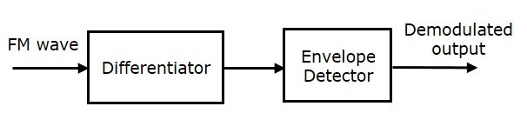
Demodulation of FM Waves
The following two methods demodulate the FM wave.
Frequency discrimination method
Phase discrimination method
Frequency Discrimination Method
This block diagram consists of the differentiator and the envelope detector. Differentiator is used to convert the FM wave into a combination of AM wave and FM wave. This means, it converts the frequency variations of FM wave into the corresponding voltage (amplitude) variations of AM wave. We know the operation of the envelope detector. It produces the demodulated output of AM wave, which is nothing but the modulating signal.

Slide 42
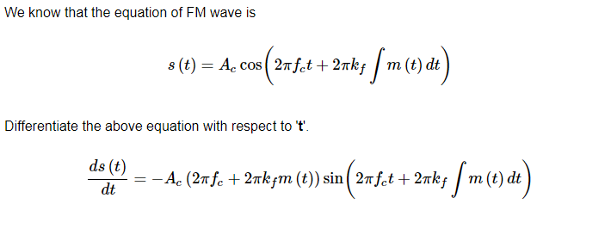
Mathematical expressions:
In the above equation, the amplitude term resembles the envelope of AM wave and the angle term resembles the angle of FM wave. Here, our requirement is the modulating signal m(t). Hence, we can recover it from the envelope of AM wave.

Slide 43
Mathematical expressions:
In the above equation, the amplitude term resembles the envelope of AM wave and the angle term resembles the angle of FM wave. Here, our requirement is the modulating signal m(t). Hence, we can recover it from the envelope of AM wave.

Slide 44
Exam Questions
(Intake 37) A FM modulator is used to transmit a tone message with an amplitude of 3.8 Volts and frequency of 18 Hz. The frequency deviation constant for the modulator is 23 Hz/V, and the carrier wave has an amplitude of 9 Volts and frequency 1.9KHz.
Find out followings:
      Power of the FM modulated signal.
ii. Appropriate bandwidth of the FM modulated signal using Carson’s rule?
(Intake 36 ) A frequency modulated voltage wave is given by following equation.
Find out followings:
    Carrier frequency
    Modulating Signal frequency
    Modulation Index
    Maximum frequency deviation
e. Power dissipated by the FM wave in 20 – Ohm Resister

Slide 45
Phase Modulation
In Phase Modulation (PM), the phase of the carrier signal varies in accordance with the instantaneous amplitude of the modulating signal.

Slide 46
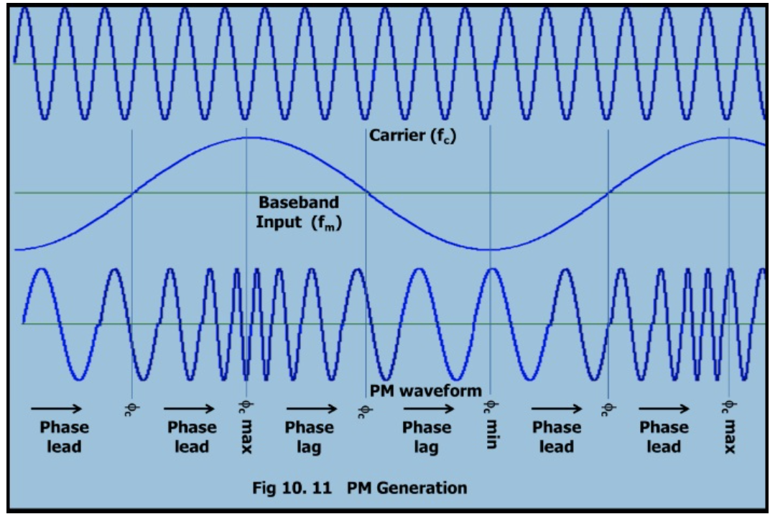

Slide 47
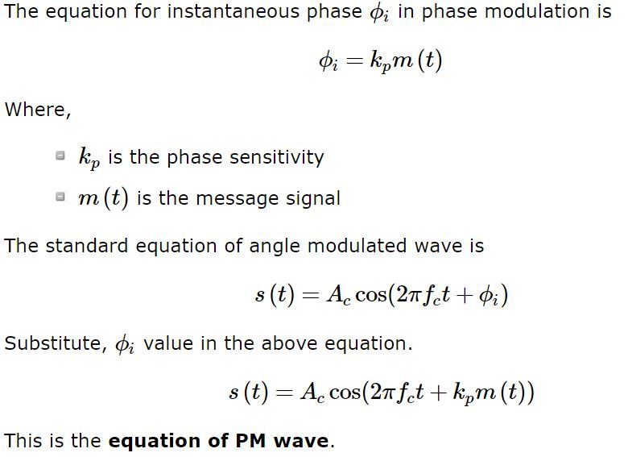
- Measured in Radians per Volts

Slide 48
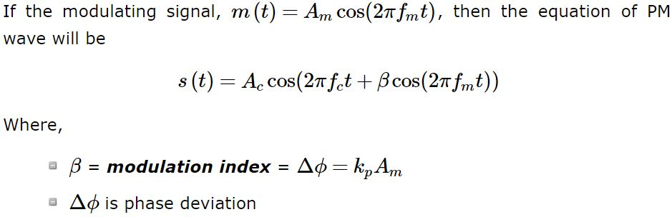
Phase modulation is used in mobile communication systems, while frequency modulation is used mainly for FM broadcasting.

Slide 49
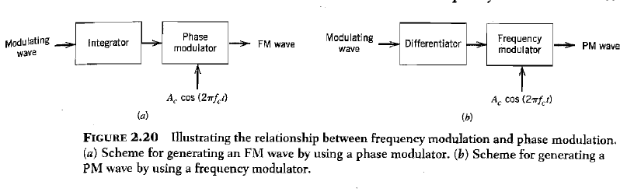
Relationship between PM and FM
An FM wave can be generated by first integrating the message signal m(t) with respect to time t and thus using the resulting signal as the input to a phase modulator.
A PM wave can be generated by first differentiating m(t) with respect to time t and then using the resulting signal as the input to a frequency modulator.

